Slide 1

NEURO COMPUTING
A Deep Learning Approach for solving Linear Programming Problems

Slide 2
TEAM MEMBERS
Polathala Bhavana – 230041026 Vangapally Pranava Reddy – 230041037 Veeramalla Akshay - 230041039

Slide 3
INTRODUCTION :
Linear Programming is a mathematical technique used to determine the best possible outcome in a given model whose requirements are represented by linear relationships.
Commonly used for maximizing or minimizing an objective function, such as profit or cost.
This report proposes a deep learning approach to solve LP problems, which composes of two parts. 1) The path followed by the decision and dual variables of an LP problem toward the optimal solution is modeled by an ODE system.
2) A feed-forward neural network is used as an approximate state solution to the ODE systems.
The idea is to bridge LP with differential equations and neural networks to approximate solutions

Slide 4

Karush-Kuhn-Tucker conditions The KKT conditions are necessary for a solution to be optimal in constrained optimization problems, such as LP. They transform the LP constraints into conditions that the solution must satisfy.
We consider the LP problem min $D^{T}x$ s.t $Ax−b$≤0 (1)
The corresponding Lagrangian is
L(x ,u)= $D^{T}x$+ $u^{T}(Ax−b)$ (2)
The corresponding Karush-Kuhn-Tucker (KKT) conditions are
$D$+ $A^{T}u$ = 0 ,
${ u}^{T}(Ax−b)$ = 0 ,
$Ax−b$≤ 0 ,
$u$ ≥ 0 , (3)

Slide 5

To approximate the solution of the LP, the problem is reformulated into an Ordinary Differential Equation (ODE) system: ODE System Formulation: The differential equation models the KKT conditions. Here, is a function defined over time, with encoding the KKT conditions. $\frac{dy}{dt}$ = Ø(y) = $\left[ \begin{matrix}\frac{dx}{dt} \\ \frac{du}{dt}\end{matrix}\right]$ = $\left[\begin{matrix}\text{−(}D \text{+ }{A^{T}\left(u+Ax−b\right)}^{+}\text{)} \\ {\left(u+Ax−b\right)}^{+}−u\end{matrix}\right]$ y($t_{0}$)= $y_{0}$ t $∈$ [0,T] Initial Condition and Time Range: The ODE is solved over the interval , starting from , with the goal of reaching an approximate solution by the endpoint .
$y^{∗}$ = ${{[x}^{∗} u^{∗}]}^{T}$ is an equilibrium point of the ODE system if and only if it is a satisfied point of the KKT conditions
The ODE system is globally convergent to the solution set $\{ y^{∗}|y^{∗}$ = ${{[x}^{∗} u^{∗}]}^{T} \}$ satisfies the KKT condition
The optimal solution to the LP problem is equivalent to the equilibrium points of the corresponding ODE system.

Slide 6

A neural network is introduced to approximate the solution to the ODE:
Training Objective: The objective is to minimize the difference between the neural network output y(t, $\text{θ}$;w) and the solution that satisfies the KKT conditions. This is done by defining a loss function E(w), which measures this error across multiple time points $t_{i}$
=> $y^{^}(t,\text{θ};w)=\left(1−e^{−t}\right)NN(t,\text{θ}\text{;}w)$
where, each different $\text{θ}$ represents a multiple LP problems.
Loss function is defined as
E(w) =$\frac{1}{|T|∗|O\left(\text{θ}\right)|}\sum_{{\text{θ}}_{j}∈ \text{O}\text{(}\text{θ}\text{) }}{\sum_{t_{i}∈ T}{l\left(\frac{∂y^{^}(t_{i},{\text{θ}}_{j};w)}{∂t_{i}},{\text{Ø}}_{j}\text{(}y^{^}(t_{i},{\text{θ}}_{j};w)\text{)}\right)}}$
Where $\text{Ø}$ refers to the ODE system associated with LP problem.
T$∈$IR refers to set of collocation times to be trained.
O($\text{θ}$) refers to set of parameters $\text{θ}$.

Slide 7

Remark:
For Single LPP :
For Single LPP $\text{θ}$ is constant ,hence can be removed.
=> $y^{^}(t;w)=\left(1−e^{−t}\right)NN(t\text{;}w)$
And Loss function can be defined as
=> E(w) = $\frac{1}{|T|}\sum_{t_{i}∈T}{l\left(\frac{∂y^{^}(t_{i};w)}{∂t_{i}}, \text{Ø(}y^{^}(t_{i};w)\text{)}\right)}$
*** The endpoint $y^{^}$(T, $\text{θ}$ ; w)=($x^{^}$, $u^{^}$) to solve the KKT conditions, where $x^{^}$ is the final prediction to the LP problem.

Slide 8
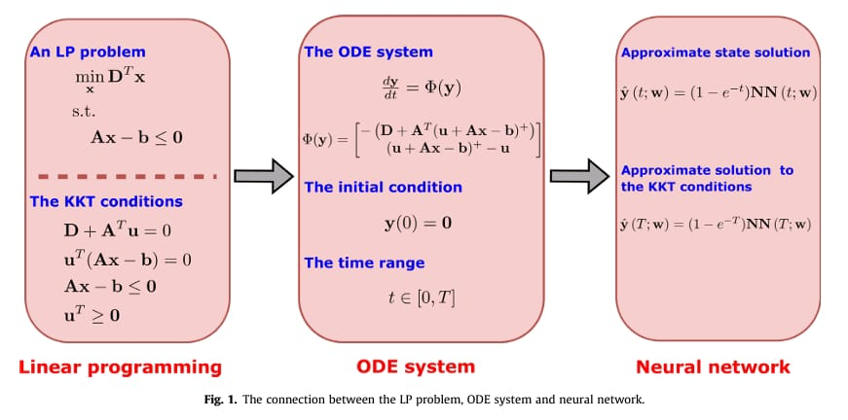

Slide 9
Steps Involved in Modeling and Solving LP Problems Using the Proposed Approach
Algorithm Steps:
1. Sample parameters and times from given distributions.
2. Compute the loss based on the current parameters and times.
3. Update the neural network weights using backpropagation.
4. Repeat until the stopping criteria are met.

Slide 10
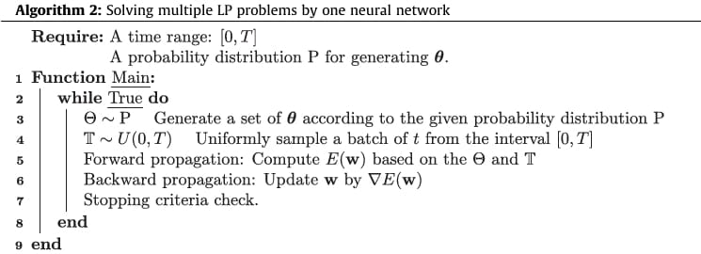

Slide 11
Practical Applications in Various Fields
Supply Chain Management: Optimizing resource allocation and logistics to reduce costs and improve efficiency.
Financial Planning: Helping in portfolio optimization and risk management by solving large-scale LP problems quickly.
Energy Sector: Enhancing power grid management and renewable energy resource planning.
Future Scope for Research and Development
Extended Applications: Exploring the use of deep learning-based LP solutions in emerging fields like quantum computing and big data analytics.
Algorithm Enhancements: Improving neural network architectures and training methodologies for better performance.

Slide 12
Conclusion :
The proposed deep learning approach offers an alternative for solving linear programming problems.
By transforming LP problems into ODE systems and leveraging neural networks, it achieves high accuracy and efficiency.
Importance of Integrating Deep Learning with LP Problems :
Combines the strengths of deep learning with traditional optimization techniques.
Addresses computational challenges of large-scale LP problems and real-time applications.
The approach has shown potential for diverse applications across multiple fields
Future research and development can further enhance its capabilities and broaden its applicability.
References :
Neurocomputing-A deep learning approach for solving linear programming problems by DAWEN WU , ABDEL LISSER .
http://www.elsevier.com/locate/neucom

Slide 13
Thank You!

